Slide 1
Science of Rocketry
Day 3

Slide 2
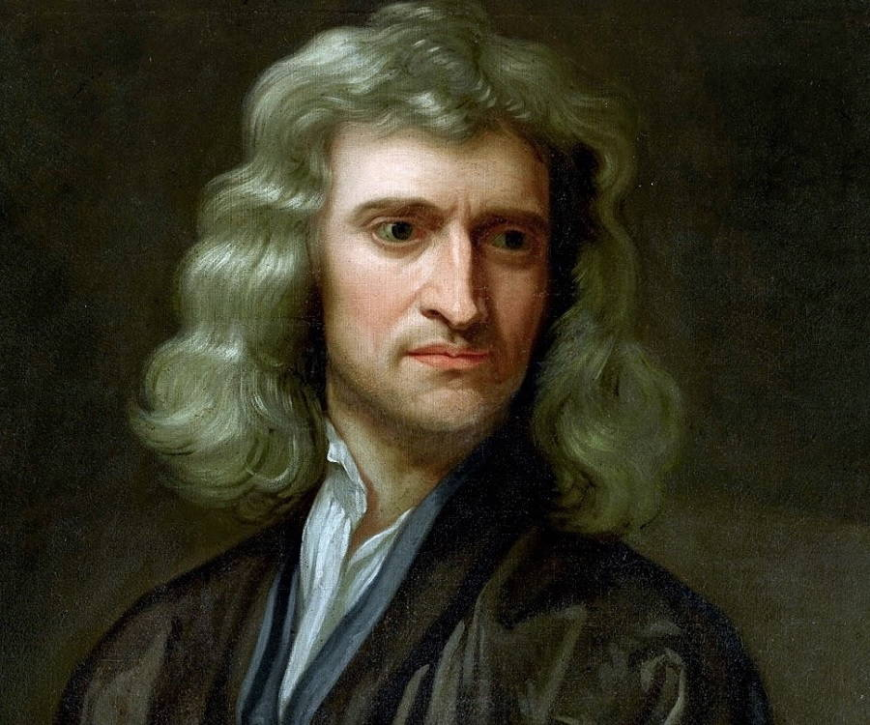
Newton’s Laws of Motion
An object at rest or at constant velocity will remain so until acted upon by an external force. (Law of inertia)
The net force on an object equals the force applied times its acceleration. (F = ma)
For every action, there is an equal and opposite reaction.

Slide 3
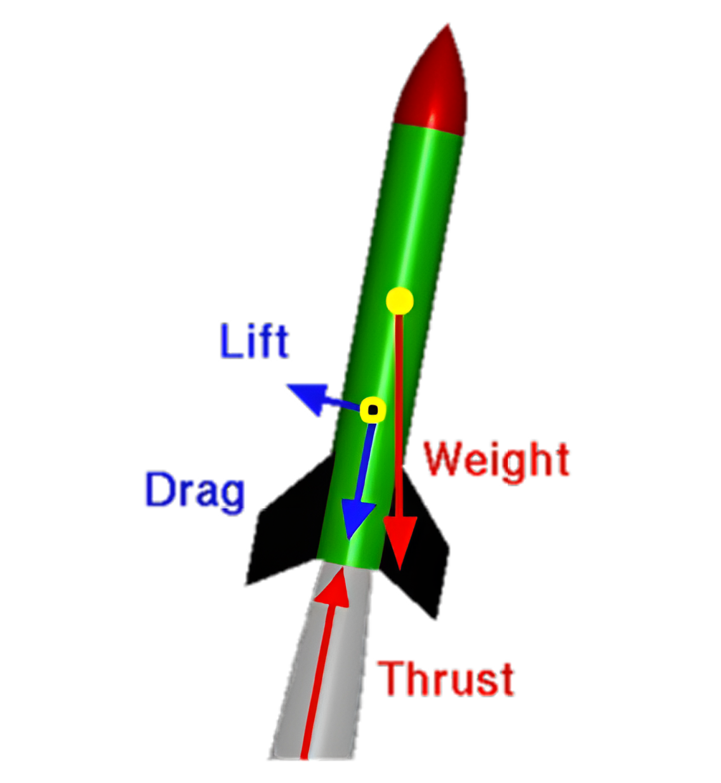
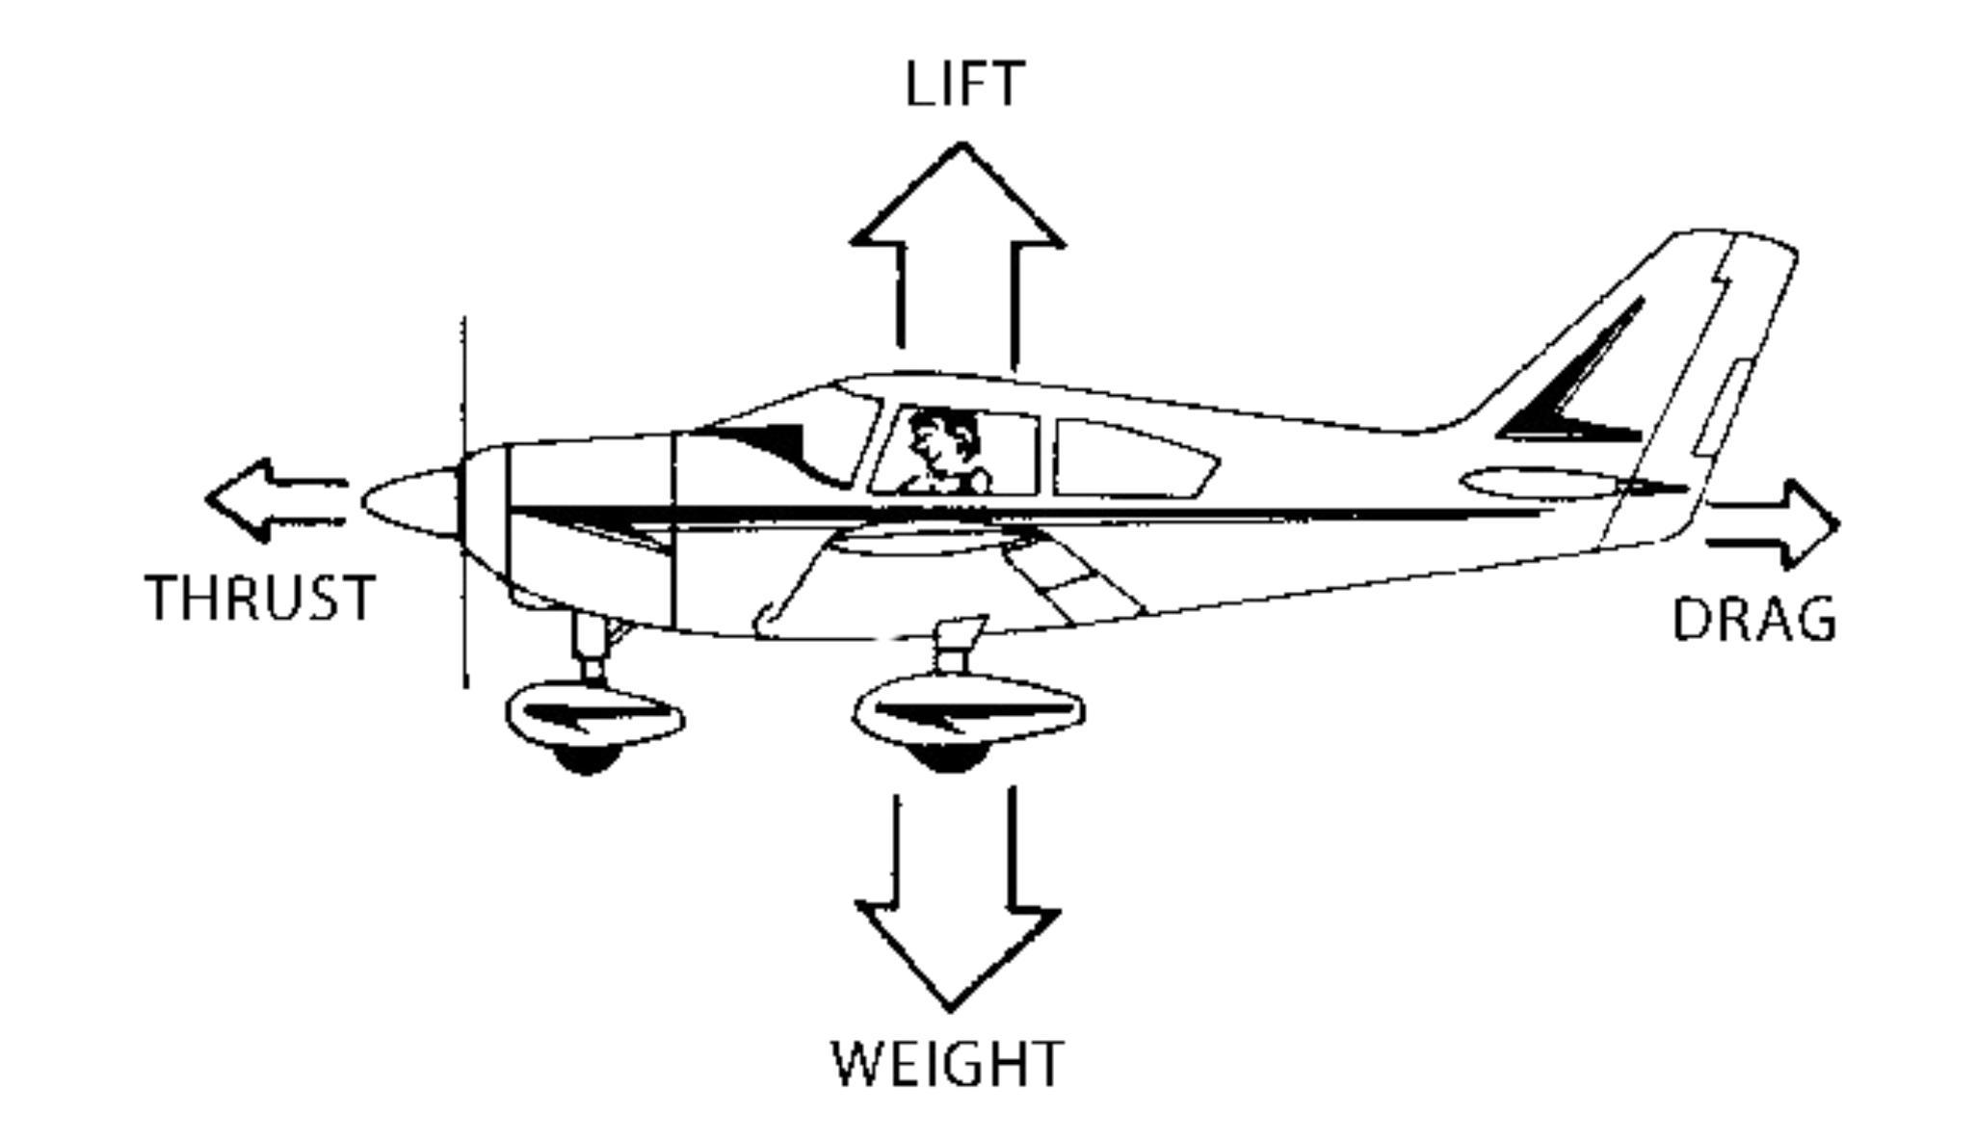
Forces on an Airplane vs Model Rocket

Slide 4
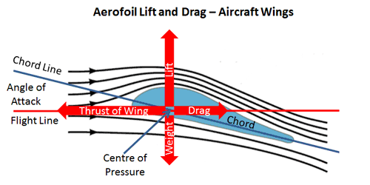
Lift Force

Slide 5
Aerodynamics of Flight
The Object:
Shape
Size
The Motion:
Velocity
Angle to airflow
The Air:
Viscosity
Density
Compressibility

Slide 6
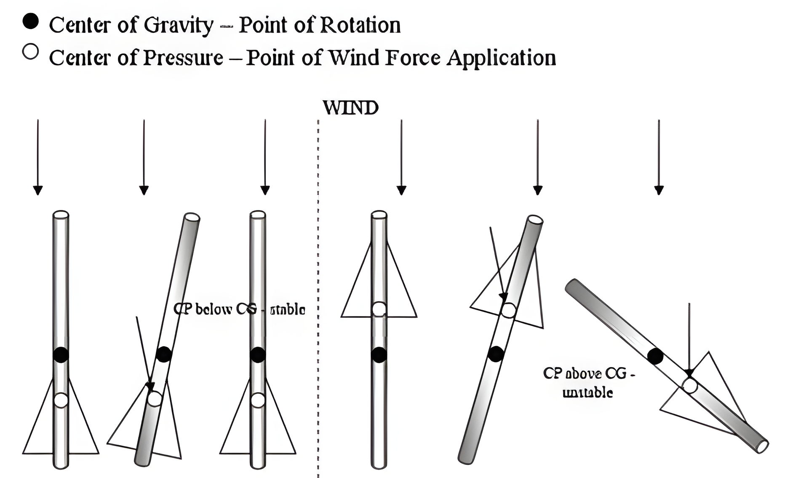
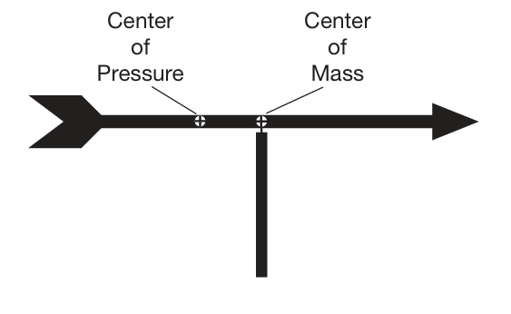
Rocket Stability

Slide 7
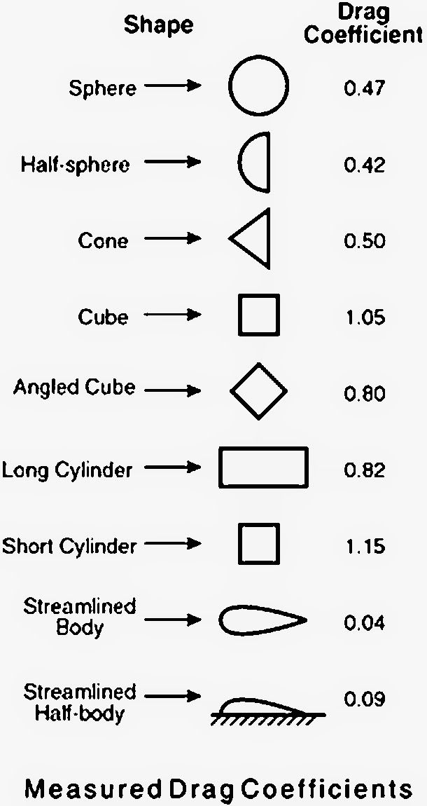
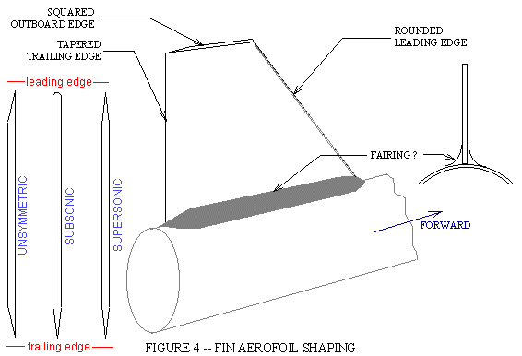
Aerodynamics

